Slide 1
Implicit Q Learning:
Improvements on Antmaze
Reporter:
廖修誼 (111652017)
吳泓諺 (111652040)
王裕昕 (111550066)

Slide 2
Outline
Part I (Introduction)
Part II (Interesting findings)
Part III (Tech. 1 - Distribution model)
Part IV (Tech. 2 - D2RL)
Part V (Tech. 3 - Bounus Reward)
Part VI (Conclusion)

Slide 3
Part I (Introduction)

Slide 4
IQL Setting
Offline RL
main insight: no need to evaluate OOD actions
method: approx. an upper expectile of distribution
Goal: minimizing the deviation from the behavior policy
Ref: (IQL) https://arxiv.org/abs/2110.06169

Slide 5
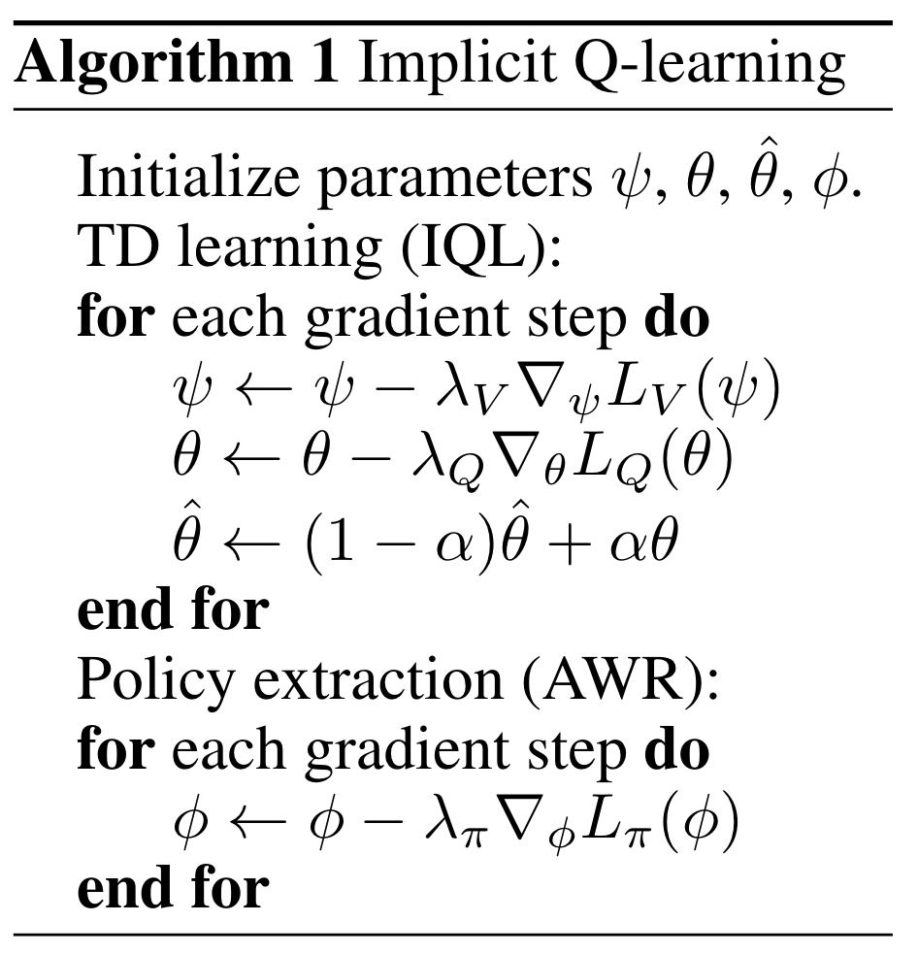



IQL algorithm
Ref: (IQL) https://arxiv.org/abs/2110.06169

Slide 6
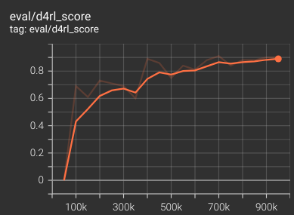
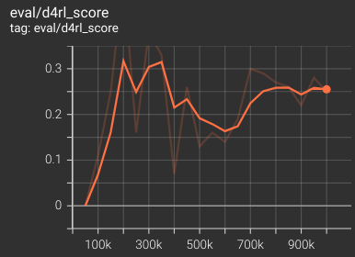
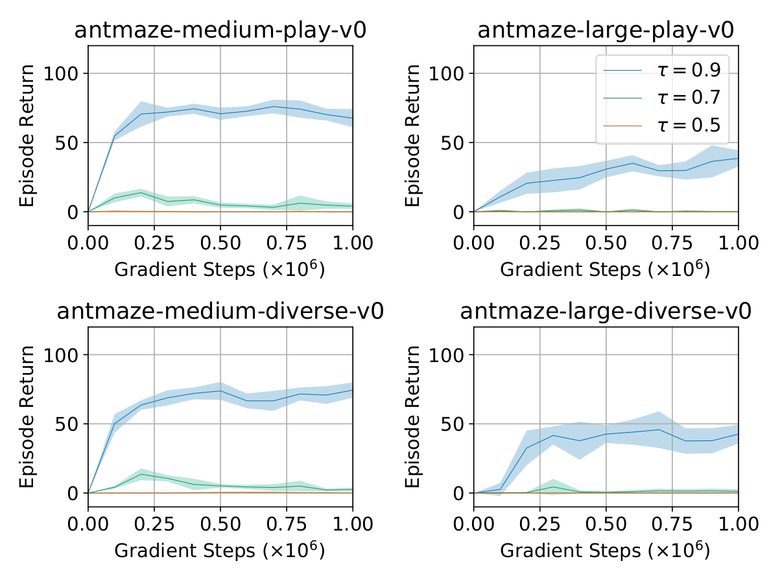
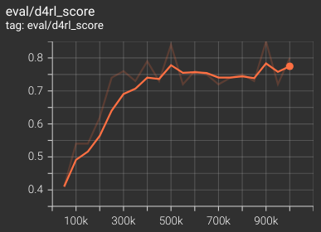
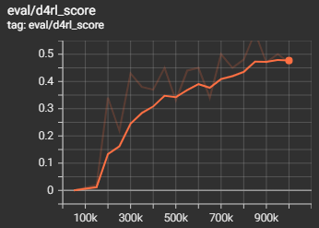
Result Reproduce (antmaze-v0)
loss hyper
parameter
umaze, τ = 0.9
large, τ = 0.9
medium, τ = 0.9
large-diverse, τ = 0.9

Slide 7
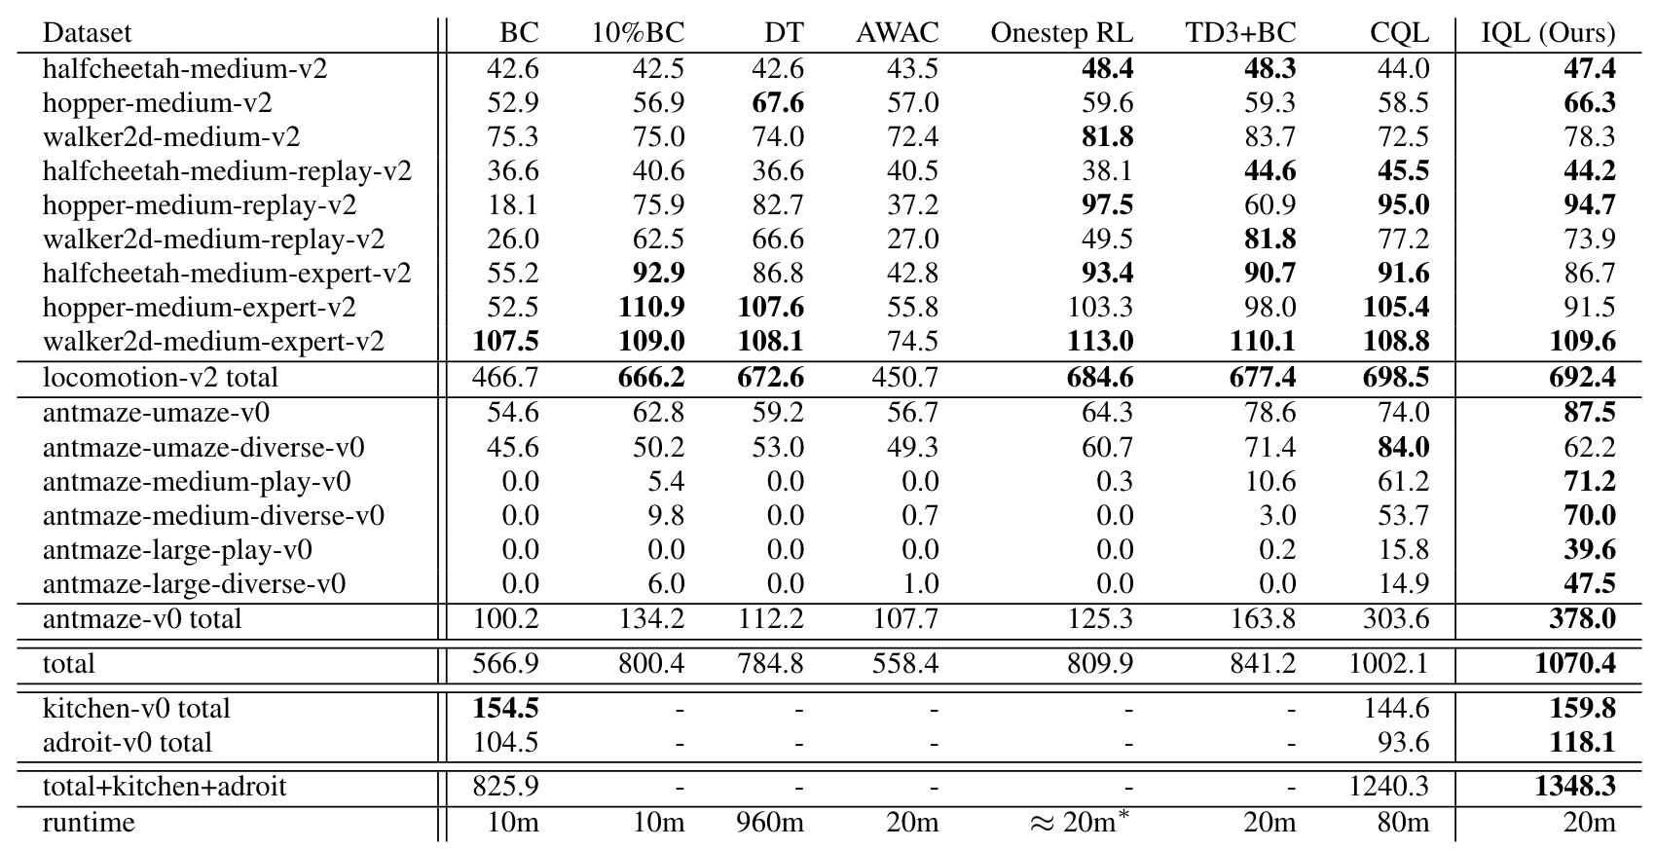
Experiment
Ref: (IQL) https://arxiv.org/abs/2110.06169

Slide 8
Part II (Interesting findings)

Slide 9
Rethink on the equation
value network:
Q < V
Q network:
Q -> r + γ * V
Policy:

Slide 10
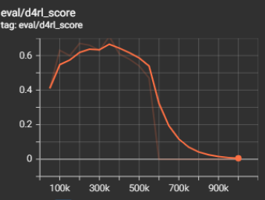
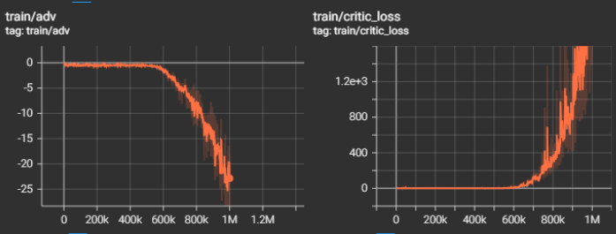
What if there is no double Q in implementation
adv = q - v

Slide 11

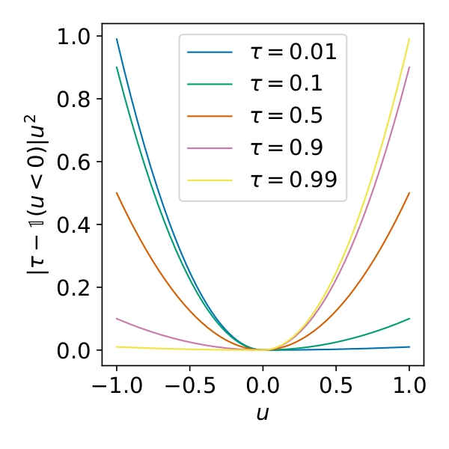
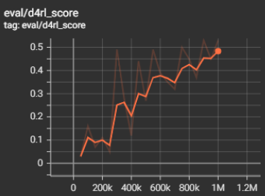
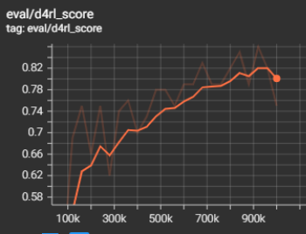

Meaning of τ
expectile = 0.8
expectile = 0.9
Ref: (IQL) https://arxiv.org/abs/2110.06169

Slide 12
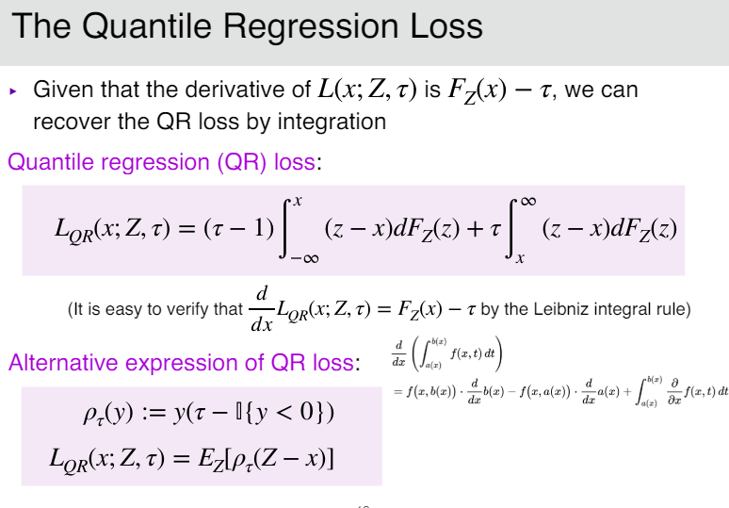

Evolve from quantile regression loss
Value loss

Slide 13
Part III (Tech. 1 - Distribution model)

Slide 14
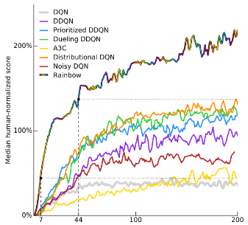
Motivation idea
improve performance with Distributionalizing IQL

Slide 15
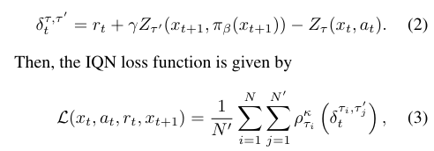

Comparison : our method & quantile
implicit quantile network
Distributional IQL
implementation follows from IQN

Slide 16


Guess , benefit of our method :
Two step policy improvement

Slide 17
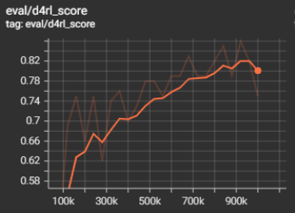
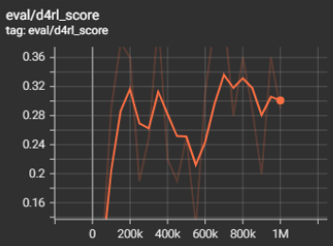
However, experiment result is …
antmaze-medium-play-v0 – expectile 0.9
antmaze-large-play-v0, expectile 0.9

Slide 18
Part IV (Tech. 2 - D2RL)

Slide 19
Motivation idea
The problem of choosing architecture designs has been largely ignored.
Information loss when forwarding through layers.
The effective rank of the feature matrix is low.
Add skip connections from the input.
Ref: https://arxiv.org/pdf/2010.09163

Slide 20
Skip Connection
original:
nn.Linear(in_dim, hidden_dim)
nn.Linear(hidden_dim, hidden_dim)
nn.Linear(hidden_dim, out_dim)
with skip connections:
nn.Linear(in_dim, hidden_dim)
nn.Linear(in_dim + hidden_dim, hidden_dim)
nn.Linear(hidden_dim, out_dim)
Ref: https://arxiv.org/pdf/2010.09163

Slide 21

Results — srank
 | antmaze-large |  | halfcheetah-expert
1M-steps | IQL | IQL+SC | IQL | IQL+SC
Policy | 227 | 232 | 226 | 232
Q-network | 223 | 231 | 225 | 233

Slide 22
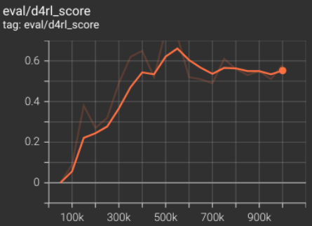
Results
competitive performance similar to original IQL
outperforms IQL on antmaze-large
prevent the reduction of effective ranks
better convergence on antmaze-large

Slide 23
Part V (Tech. 3 - Bonus Reward)

Slide 24
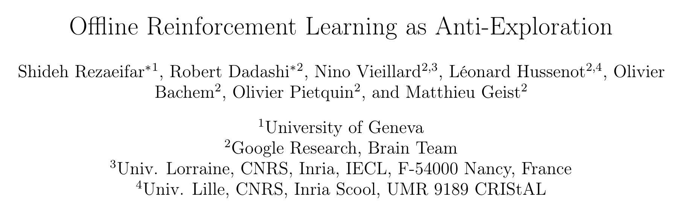
Motivation idea
Ref: (anti-exploration) https://arxiv.org/abs/2106.06431

Slide 25
(subtractive) Bounus Reward Property
P((s, a) in D)
b(s, a)
less probable to occur OOD
Ref: (anti-exploration) https://arxiv.org/abs/2106.06431

Slide 26
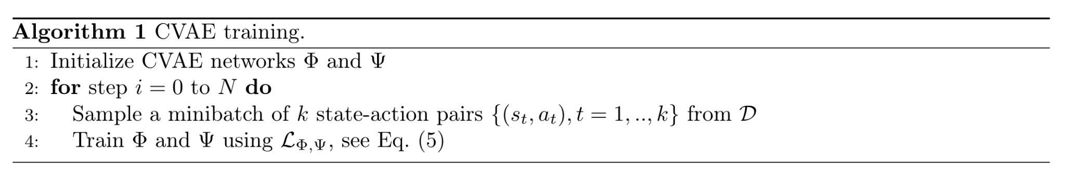
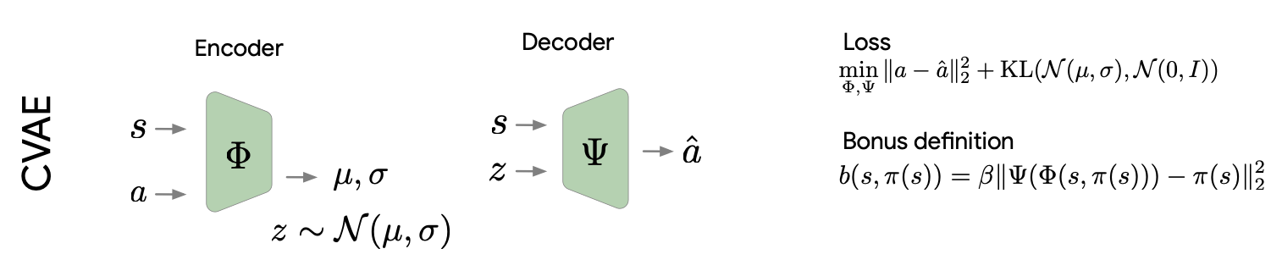
Train Bounus Reward (CVAE)
depends on complexity of replicating action
Ref: (anti-exploration) https://arxiv.org/abs/2106.06431

Slide 27
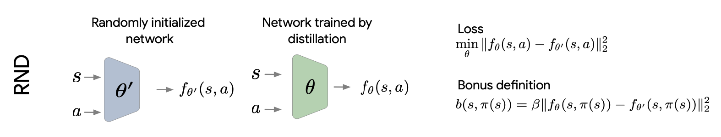
Train Bounus Reward (RND)
depends on complexity of replicating action
Ref: (anti-exploration) https://arxiv.org/abs/2106.06431

Slide 28

Apply Bounus Reward to IQL
Ref: (IQL) https://arxiv.org/abs/2110.06169

Slide 29
Part VI (Conclusion)

Slide 30
Recall
Part I (Introduction)
Part II (interesting findings)
Part III (Tech. 1 - Distribution model): modify update formulas to distribution form
Part IV (Tech. 2 - D2RL): modify neural layers
Part V (Tech. 3 - bonus reward): modify reward

Slide 31
Thank you for your attention

